Slide 1
CYBER SECURITY
PRESENTED BY:
THIRUMULLAI T &
MAHALAKSHMI K

Slide 2
CONTENT
INTRODUCTION
MAJOR SECURITY PROBLEMS
CIA TRIAD
APPLICATION

Slide 3
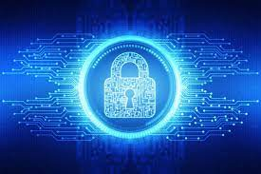
INTRODUCTION
Cybersecurity is the process of protecting data,electronic systems and network against cyber attacks.
It is necessary since it helps in securing data from the threats such as data theft or misuse,also safeguard your system from viruses.

Slide 4
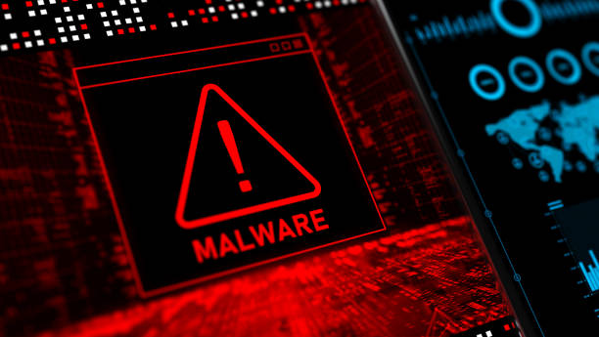
MAJOR SECURITY PROBLEMS
MALWARE
Malware is any software that infects and damages a computer systems without the owner’s knowledge or permission.
prevention:
Activate Network Threat Protection,Firewall,Antivirus

Slide 5

2. PHISHING ATTACK
Phishing attacks are the practice of sending fraudlent
communications that appear to come from a reputable source.
It is usually done through email.The goal is to steal sensitive
data like credit card and login information or to install malware
on the victim’s machine.
prevention:
Be suspicious of unexpected emails
make use of anyi-malware software

Slide 6
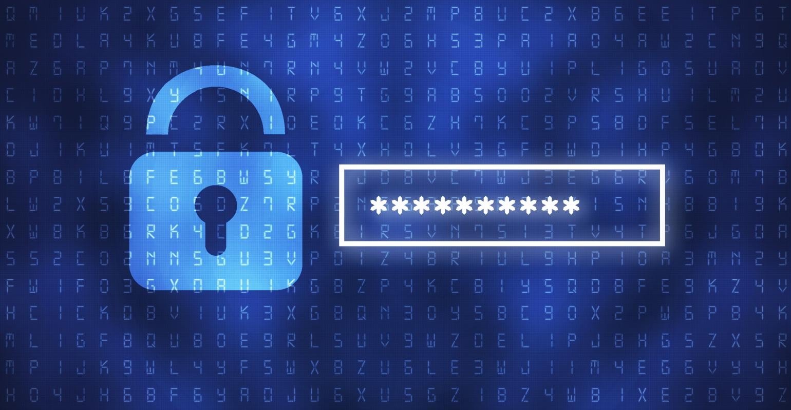
3. PASSWORD CRACKING:
Password attacks are attacks by hackers that are able to determine
passwords or final passwords to different protect electronics areas
and social network sites.
Prevention:
use always strong password.

Slide 7
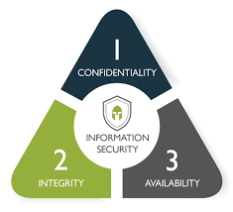
CIA TRIAD

Slide 8
CIA TRIAD - 3 PILLARS OF CYBER SECURITY
1.CONFIDENTIALITY:
prevent sensitive information from unauthorized acesss
attempts using encryption algorithm.
More or less stringent measures can then be implemented
according to those categories.

Slide 9
2.INTEGRITY:
Involves maintaining the consistency ,accuracy and trustworthiness of data over its entire lifecycle.
Data must not be changed in transit.
uses hashing for saving the file.

Slide 10
3.AVAILABILITY:
Information should be consistently and readily accessible for
authorized parties.

Slide 11
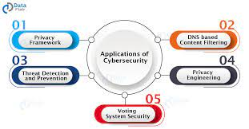

Slide 12
OUTCOMES
Upon the completion of this session,the learner will be able to
Define cyber security
know the key objectives of cyber threats
understands the CIA triad
know the application of cyber security

Slide 13


